Slide 2
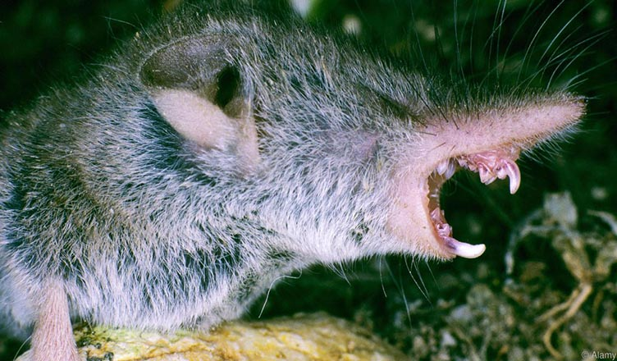
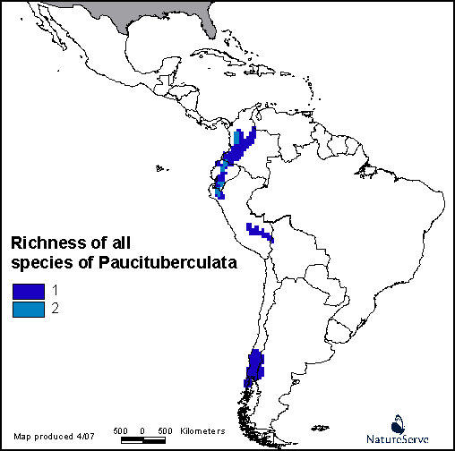
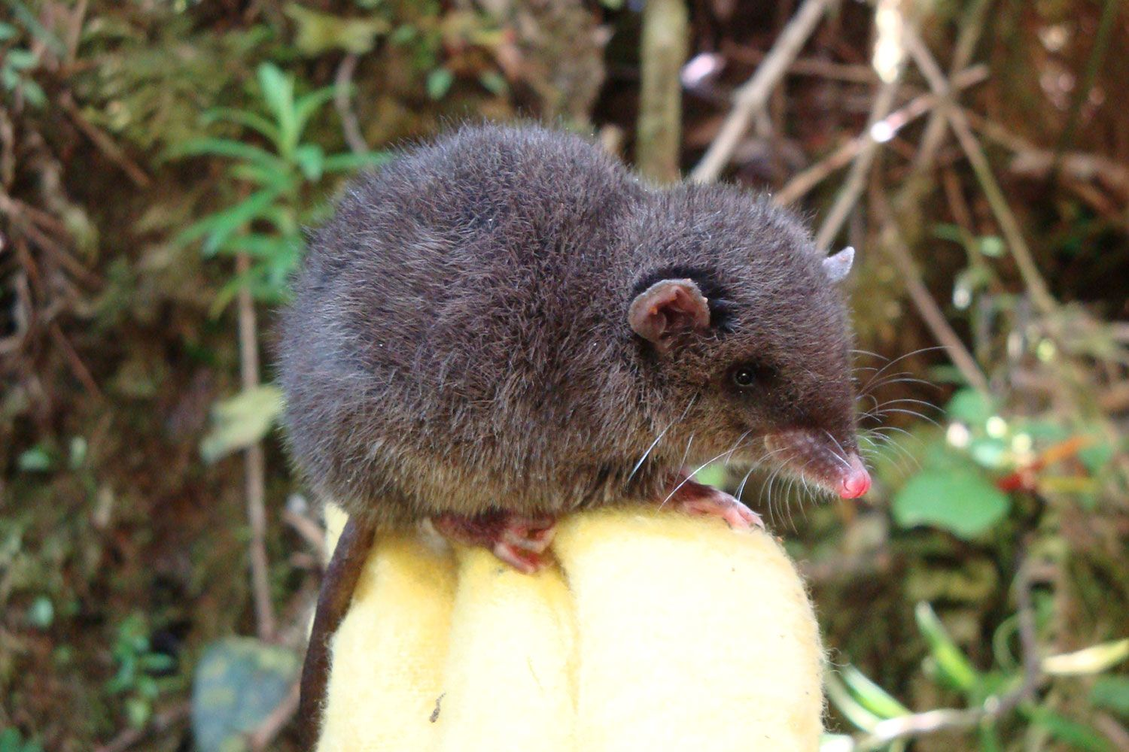
Paucituberculata – Shrew Opossums

Slide 3
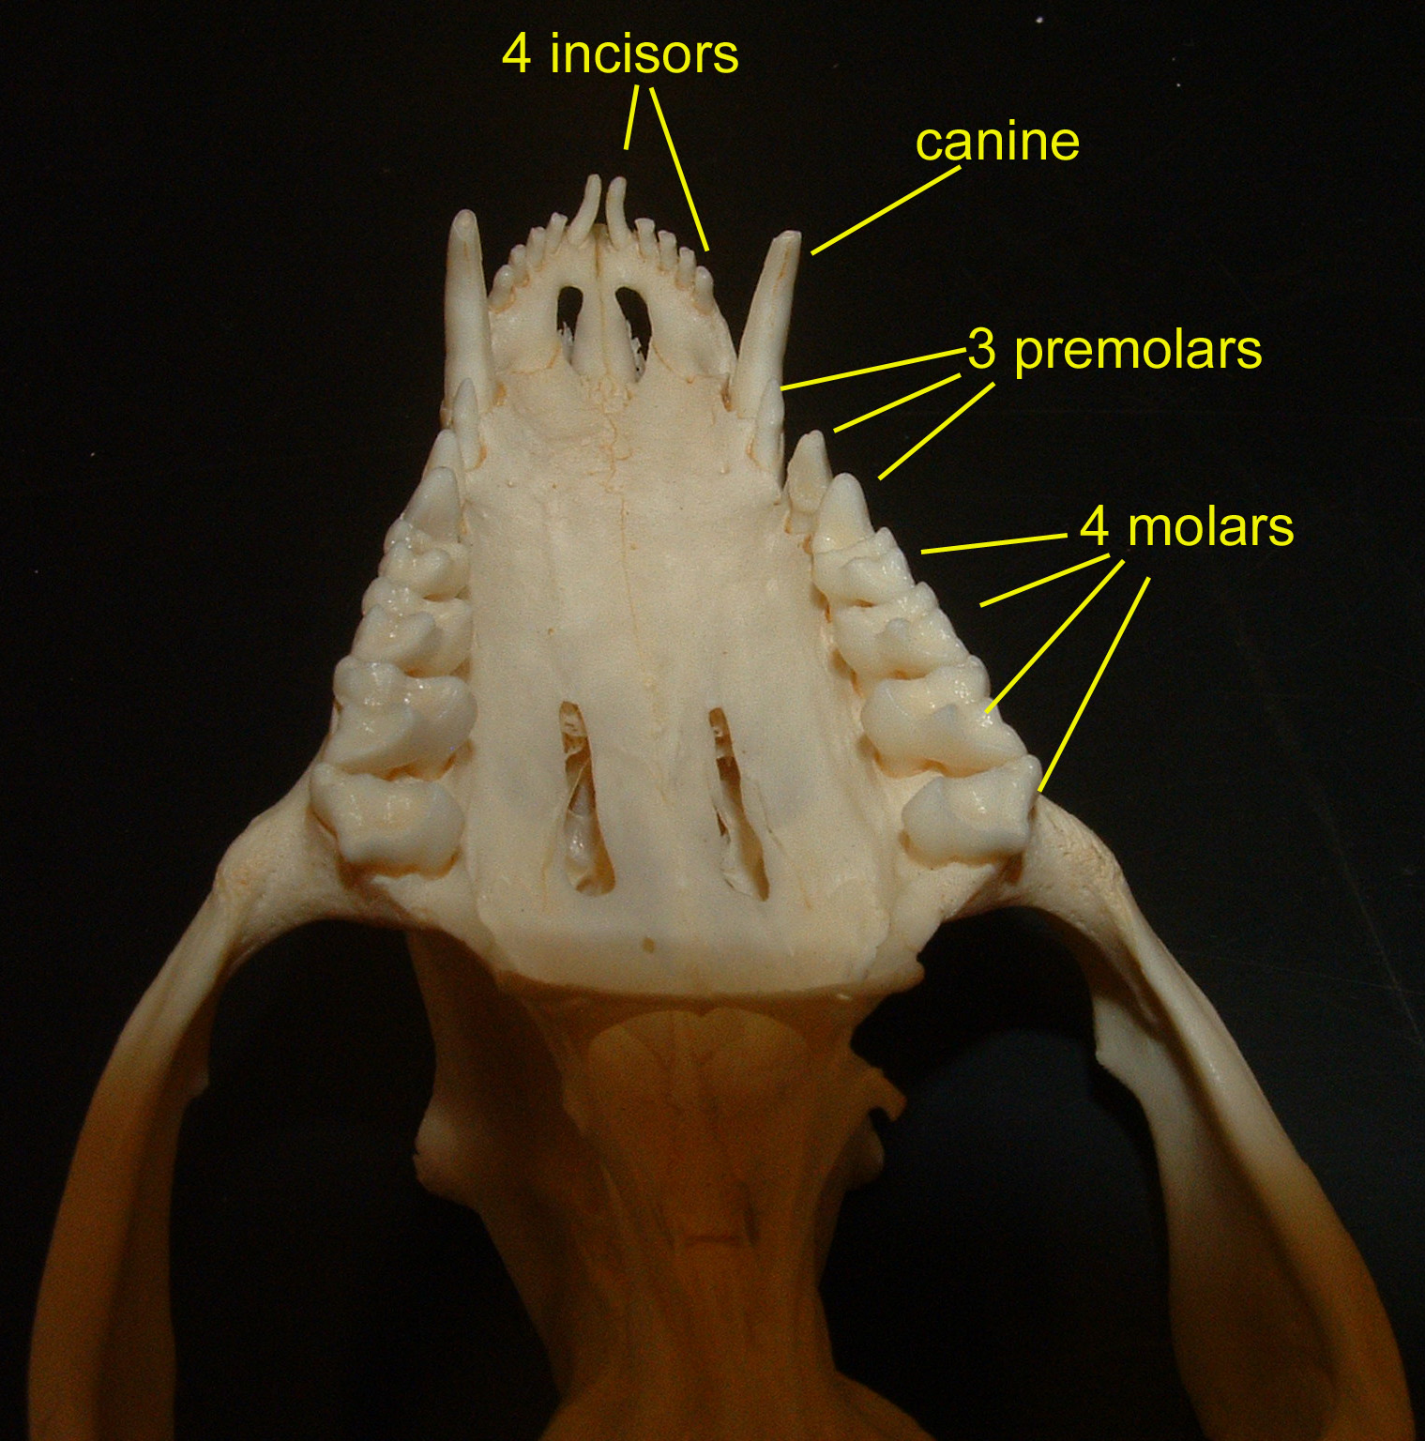
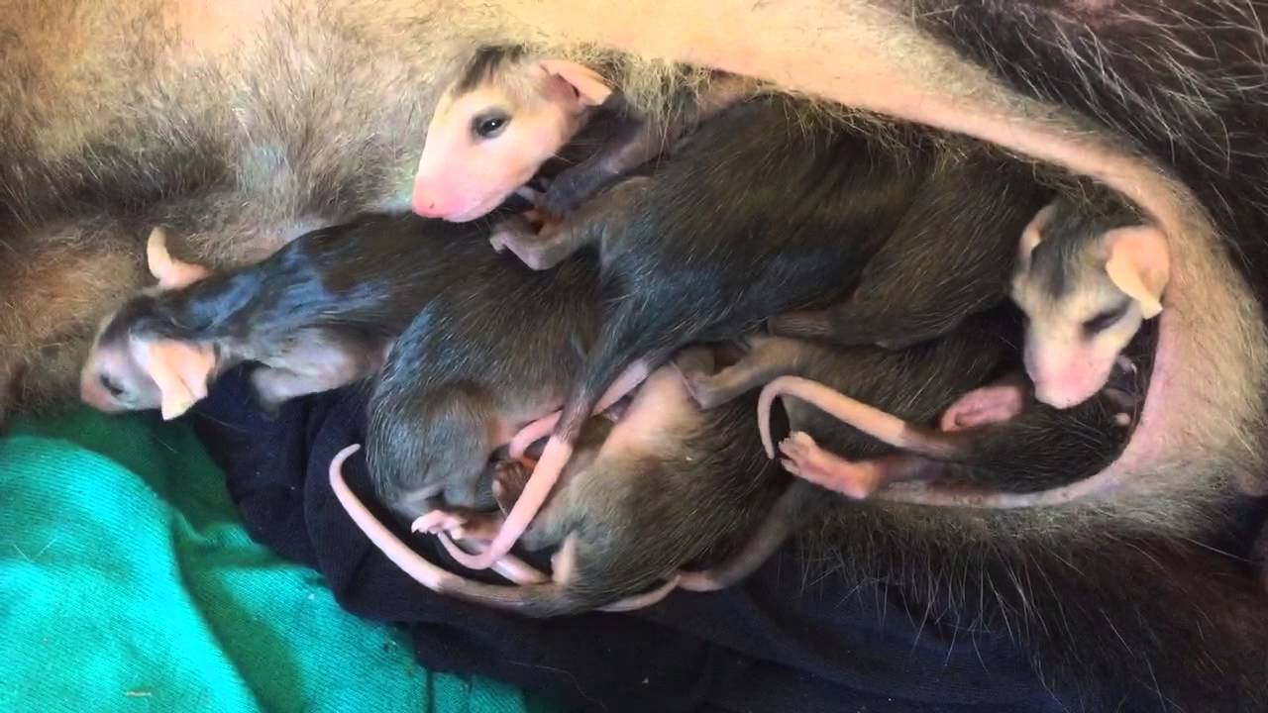
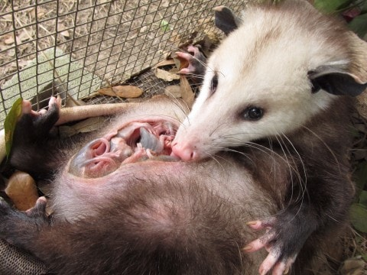
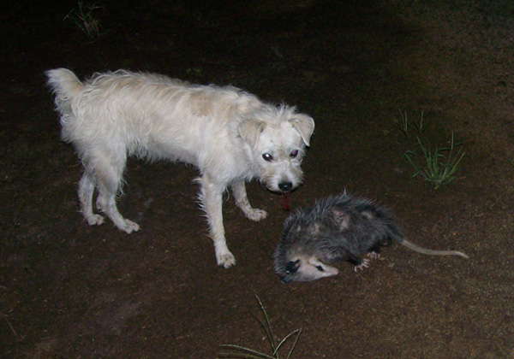
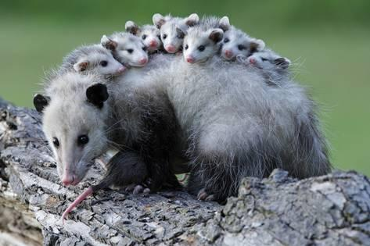
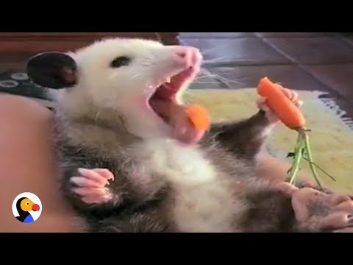
Didelphidae – Opossums

Slide 4
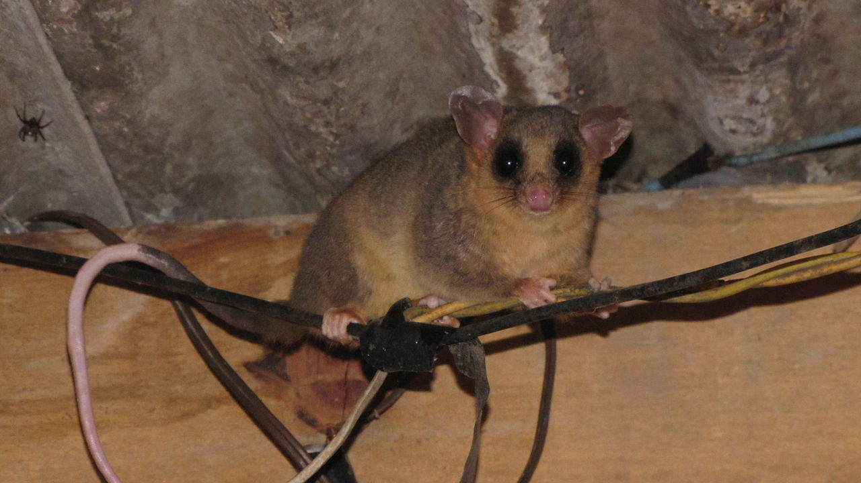
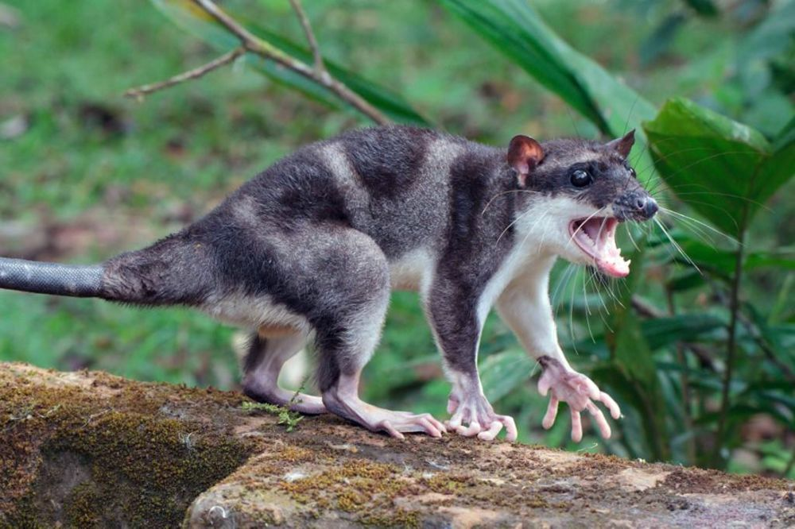
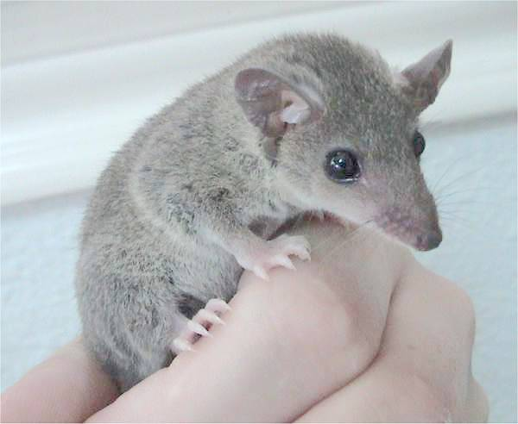
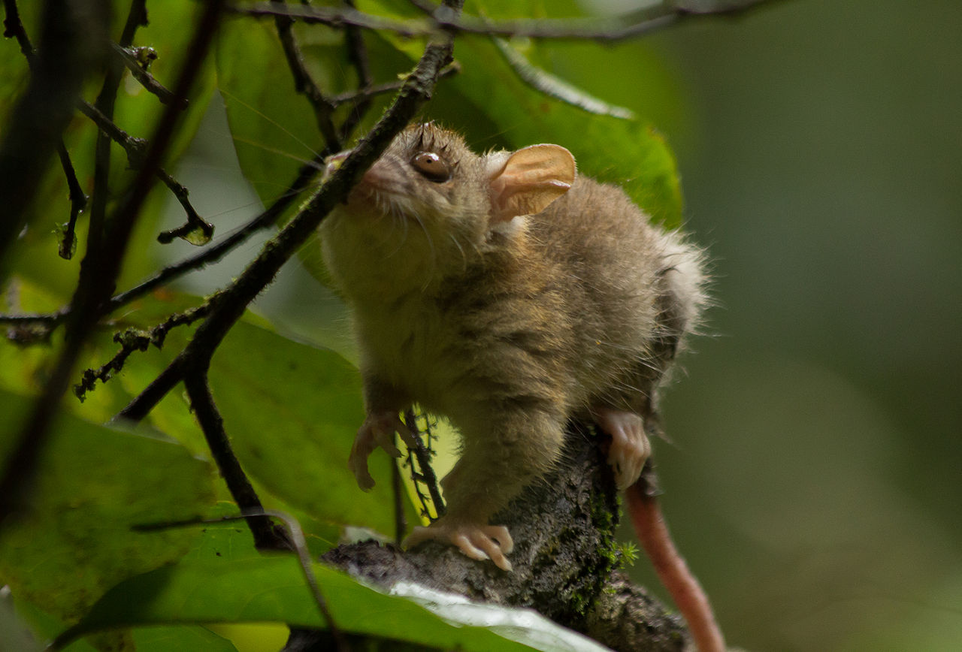
Didelphidae – Opossums (~100 species)

Slide 5
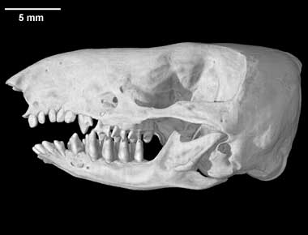
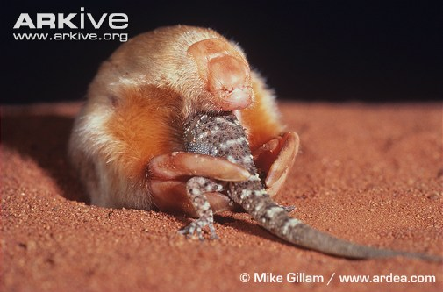
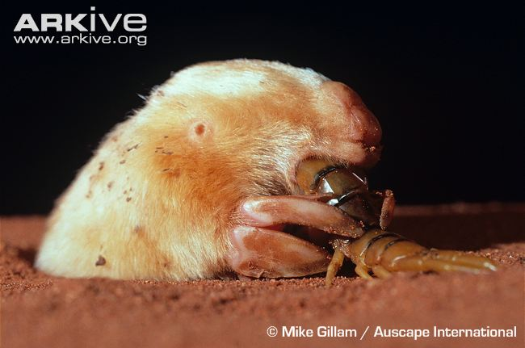
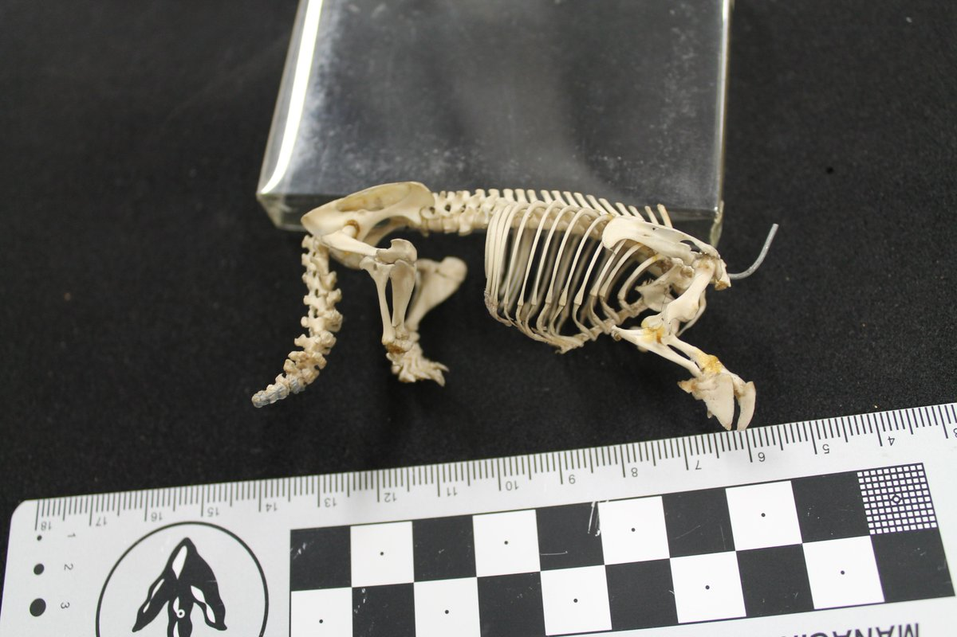
Notoryctes – Marsupial mole

Slide 6
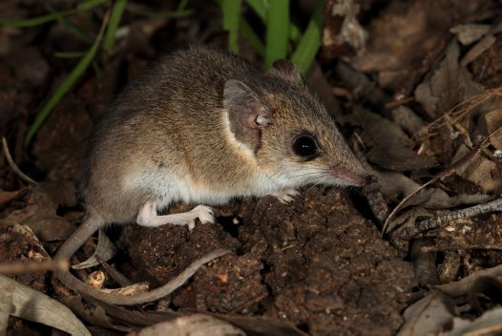
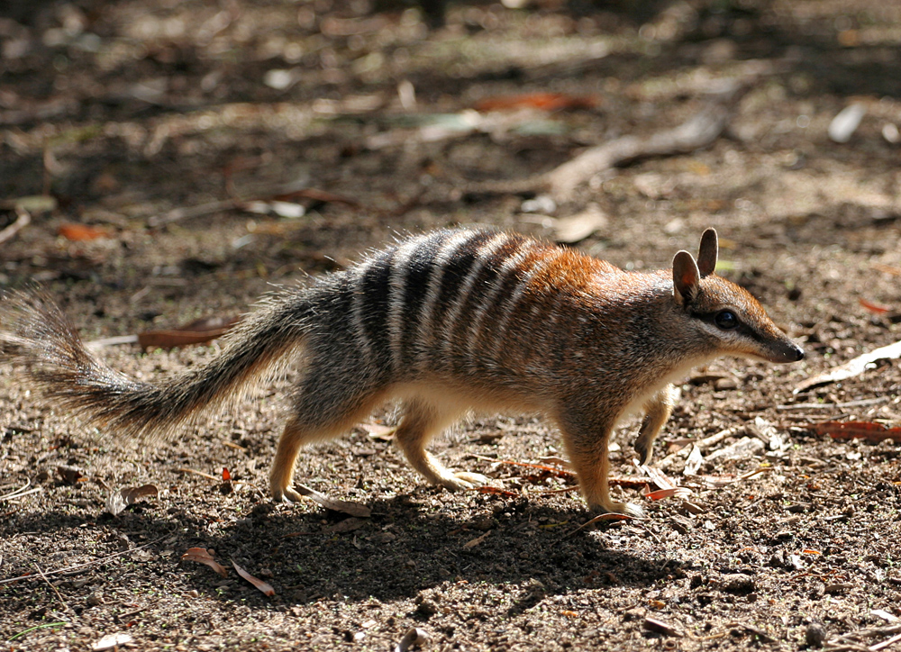
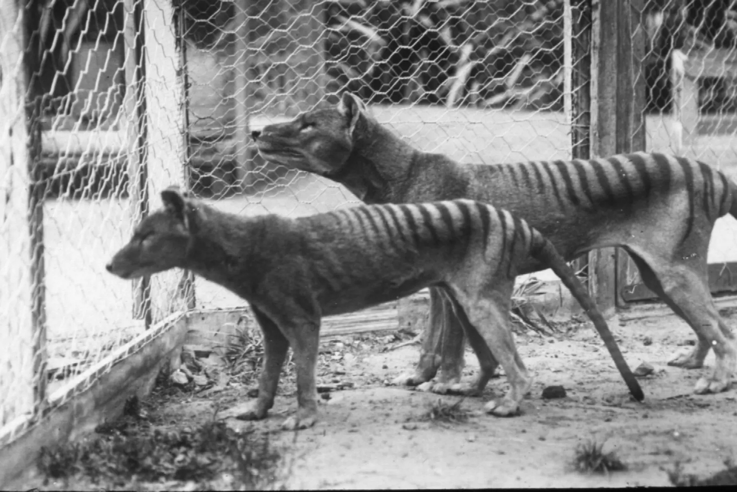
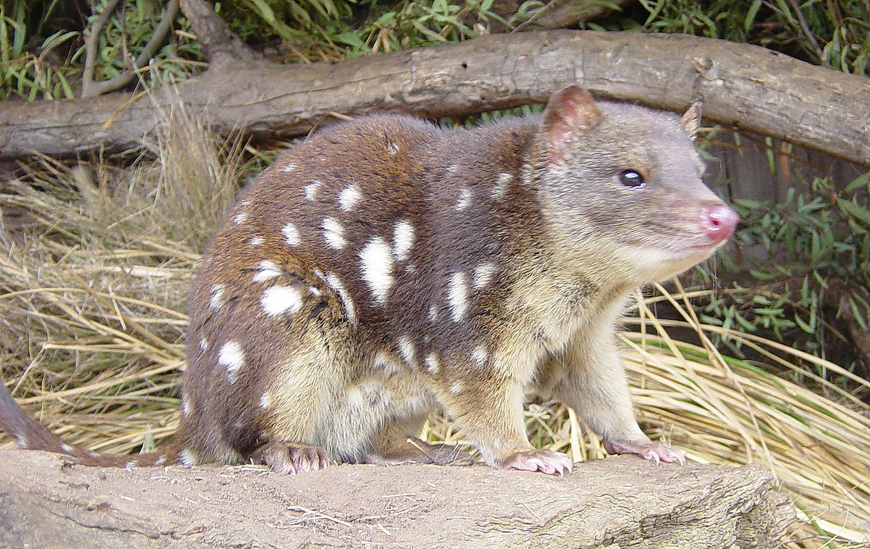
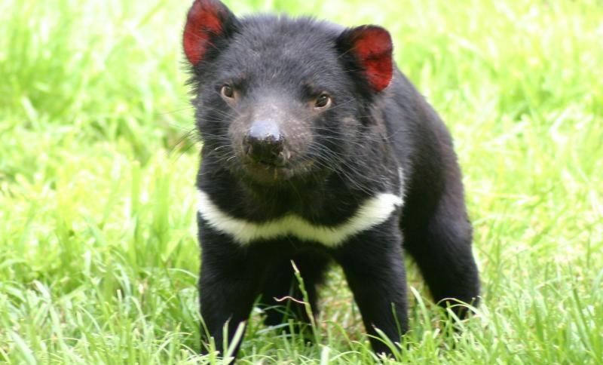
Dasyuromorphia
Notes:
Top left: Dunnart
Bottom left: Quoll
Top middle: Numbat
Top right: tazzy tiger
Bottom right tazzy devil

Slide 7
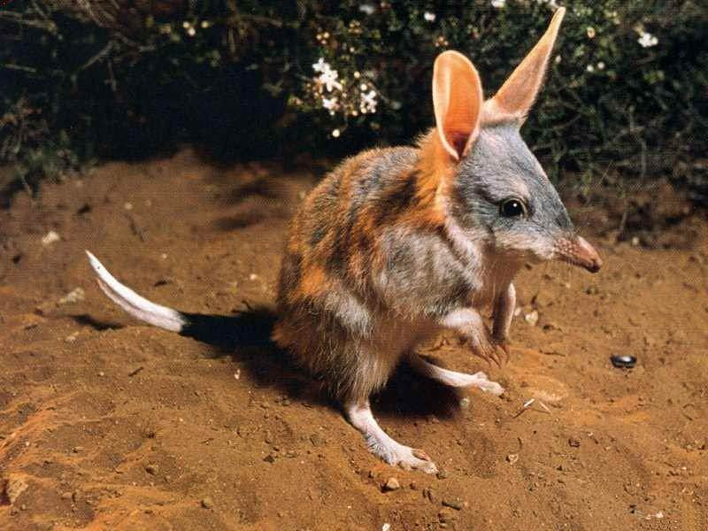
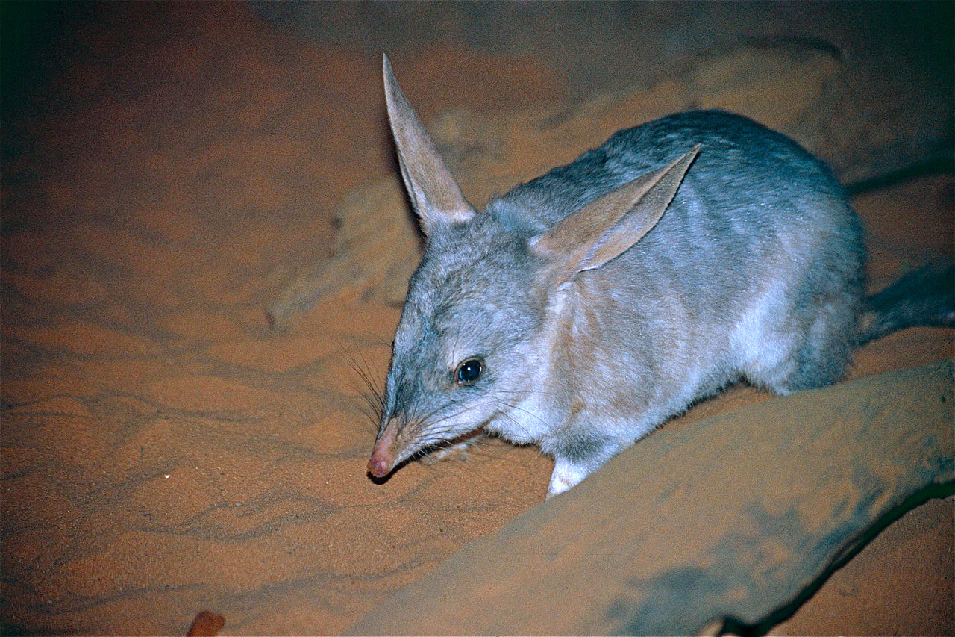
Peramelemorphia – Bandicoots and Bilbies

Slide 8
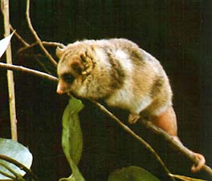
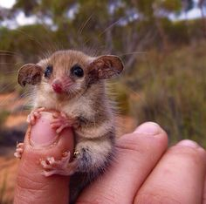
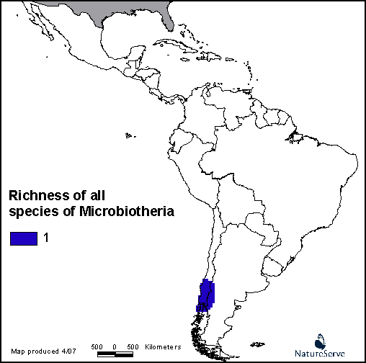
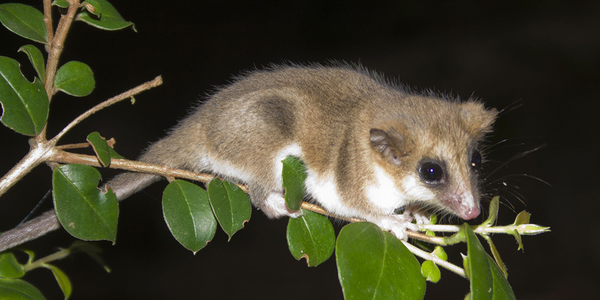
Microbiotheria

Slide 9
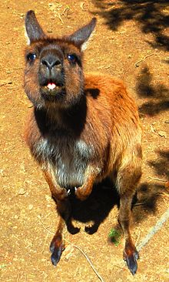
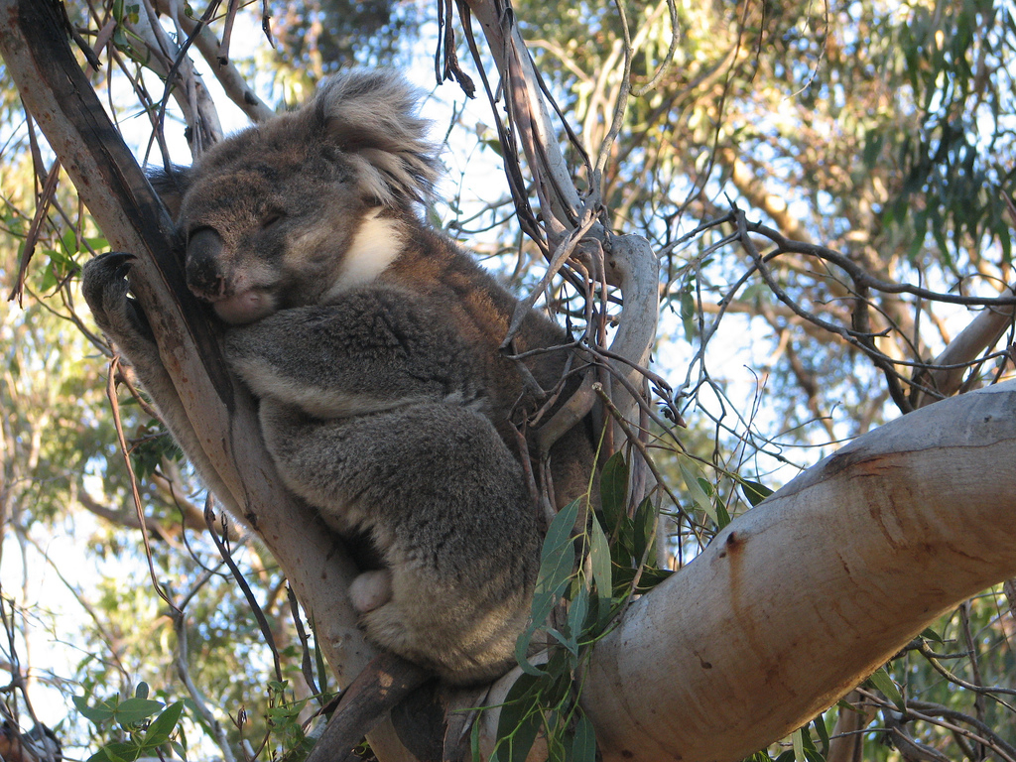
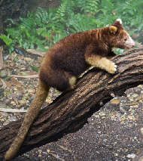
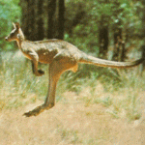
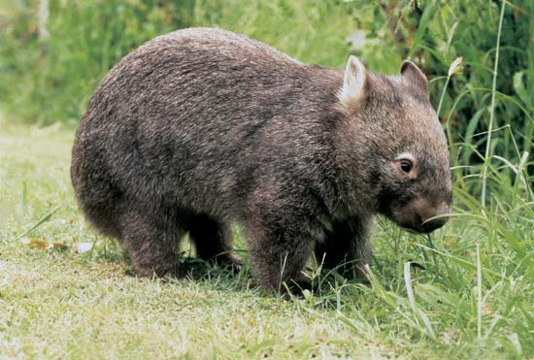
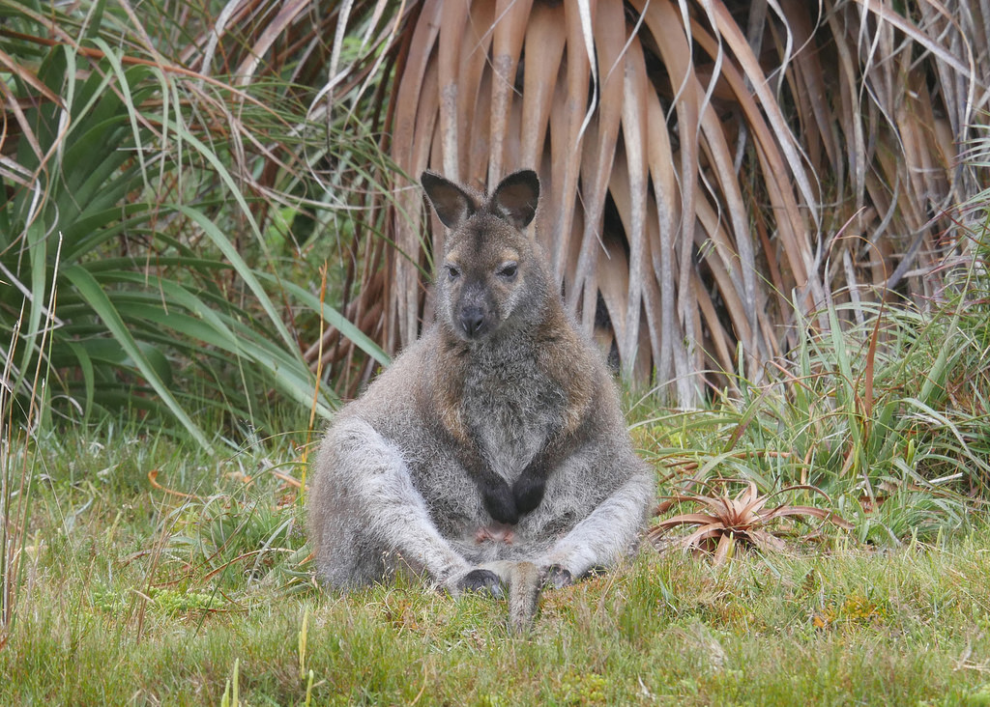
Diprotodontia

Slide 10
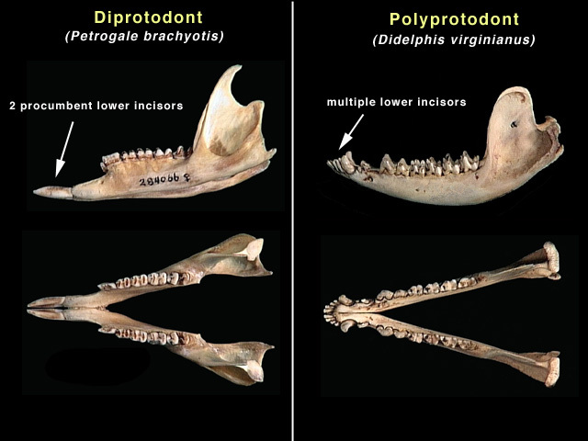
Diprotodontia

Slide 11
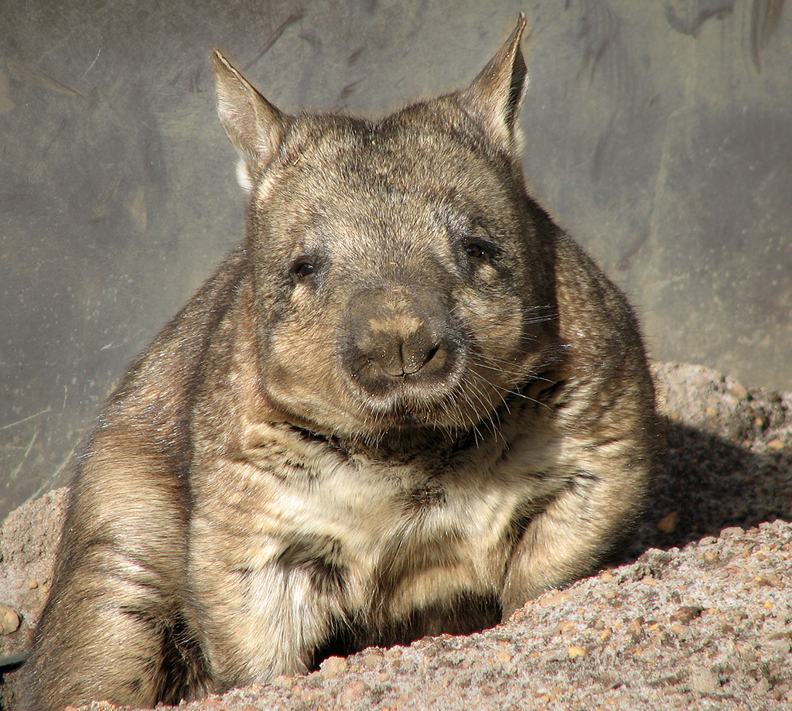
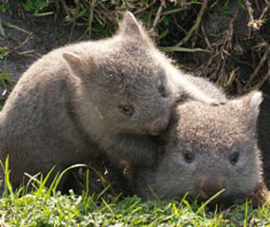
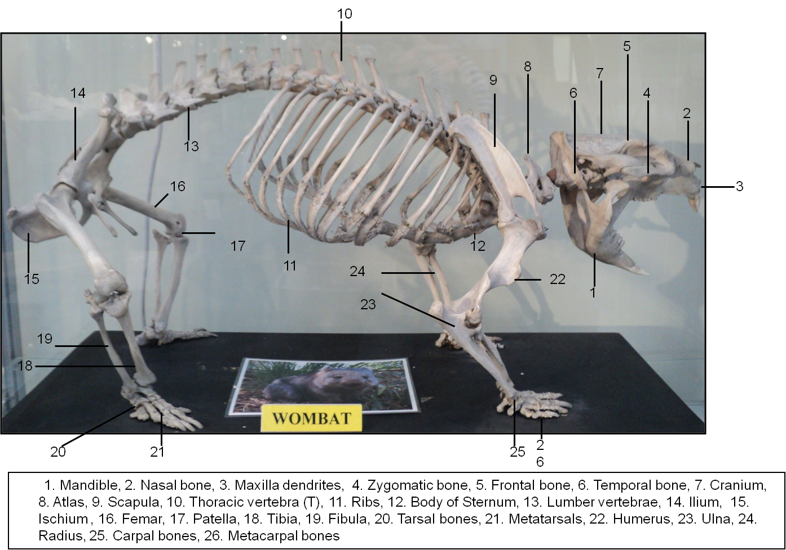
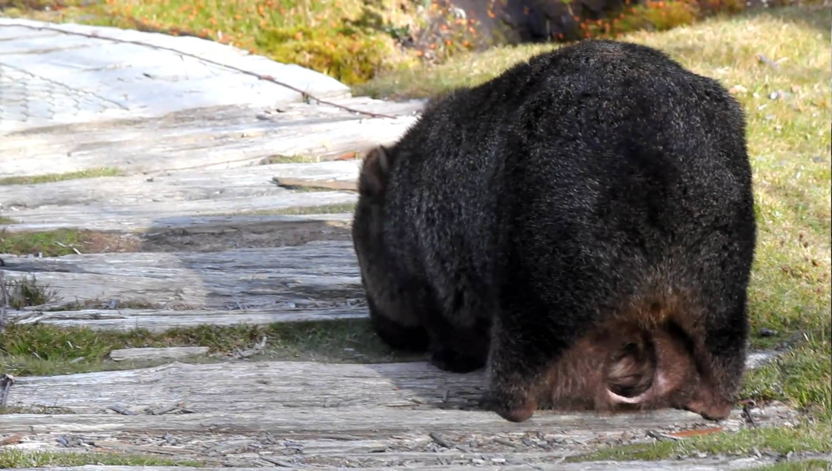
Vombatiformes: Vombatidae

Slide 12
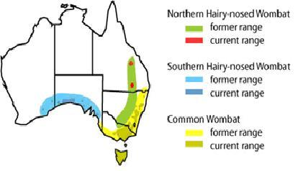
Vombatiformes: Vombatidae

Slide 13
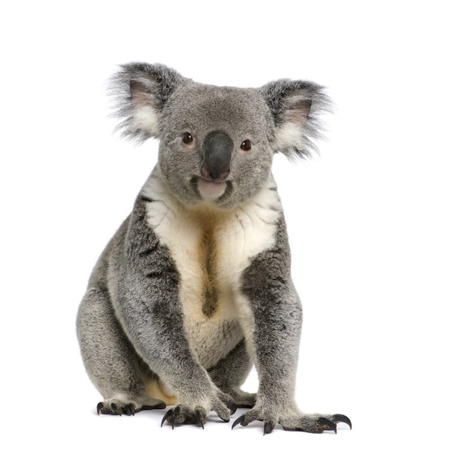
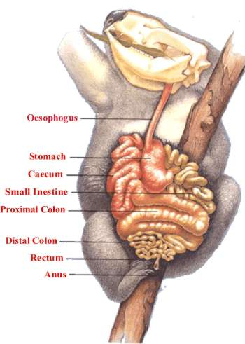
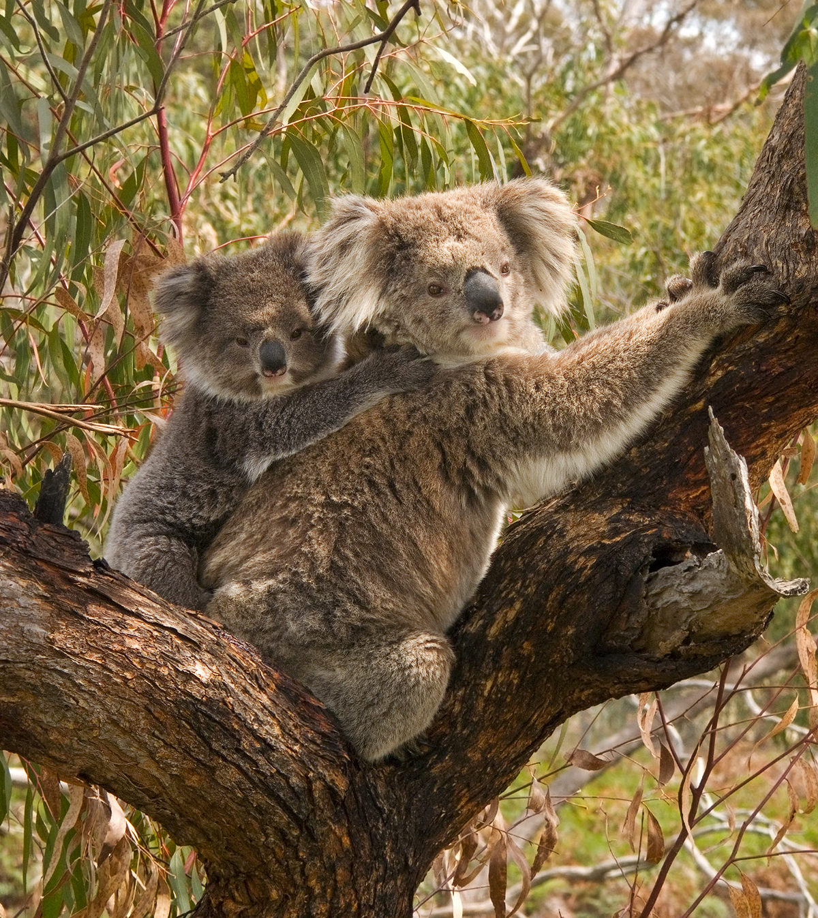
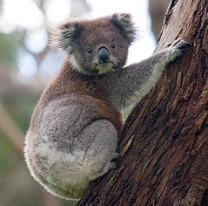
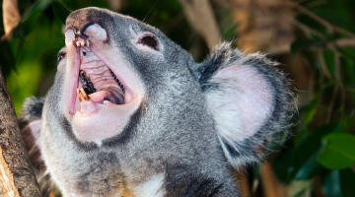
Vombatiformes: Phascolarctos
https://www.youtube.com/watch?v=ocIR6B-YtYE
Notes:
https://www.youtube.com/watch?v=ocIR6B-YtYE
https://www.nature.com/news/discovery-of-organ-explains-koalas-super-bass-notes-1.14275

Slide 14
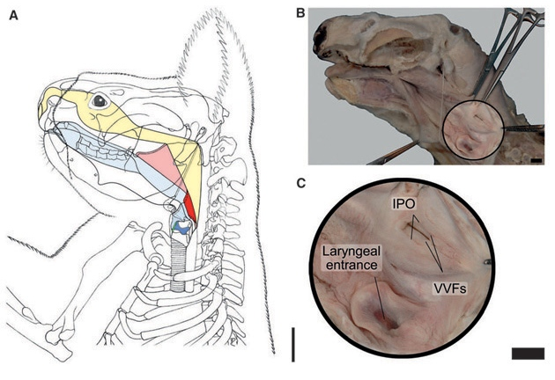
Vombatiformes: Phascolarctos
Notes:
“Velar” larynx
https://www.youtube.com/watch?v=ocIR6B-YtYE
https://www.nature.com/news/discovery-of-organ-explains-koalas-super-bass-notes-1.14275

Slide 15
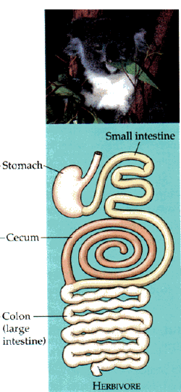
Vombatiformes: Phascolarctos
Notes:
Hindgut fermentation
Typical lose microbes to feces
Cecum extremely helpful here. Over a meter long and ~a third of the total alimentary volume

Slide 16
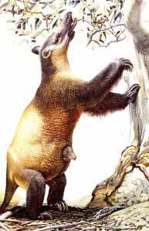
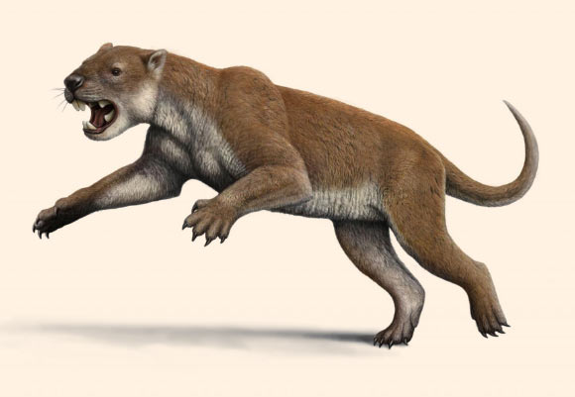
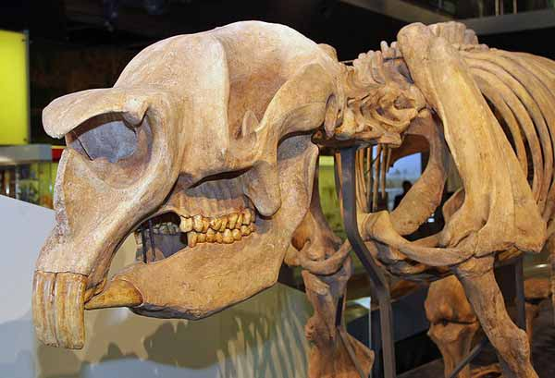



Vombatiformes: Extinct members
Notes:
https://www.nature.com/news/discovery-of-organ-explains-koalas-super-bass-notes-1.14275

Slide 17

Vombatiformes: Extinct members
Notes:
https://www.nature.com/news/discovery-of-organ-explains-koalas-super-bass-notes-1.14275

Slide 18


Vombatiformes
Notes:
Koala brain is ~0.2% of its body mass

Slide 19






Phalangeridae Cuscuses, sugar gliders, brushtailed possums

Slide 20





Phalangeroidea: Burramyidae Pygmy possums

Slide 21



Macropodiforms: Hypsiprymnodon Rat-kangaroo

Slide 22






Macropodiforms: Potoroidae Bettongs, potoroos, boodies, and woylies

Slide 23






Macropodiforms: Macropodidae Kangaroos, tree-kangaroos, and wallabies

Slide 24



Macropodidae

Slide 25


Macropodiforms: Macropodidae Kangaroos, tree-kangaroos, and wallabies

Slide 26


Slide 27


Slide 28


Notes:
https://royalsocietypublishing.org/doi/10.1098/rsbl.2014.0381

Slide 29

Pentapedal locomotion

Slide 30







Petauroidea: More Possums!!

Slide 31

Petauroidea: More Possums!!

Slide 32


Marsupial Reproduction

Slide 33


Marsupial Reproduction

Slide 34



Slide 35


Slide 36

Placenta made of chorion & vitelline vessels

Slide 37


Slide 38

Eutheria
Euarchontoglires
Laurasiatheria

Slide 39


Xenarthra
No enamel!
Armadillos: South & North America
Pilosa
Sloths: South & Central America (6 sp)
Anteaters: South America (4 sp)

Slide 40






Xenarthra: Armadillos (21 sp)

Slide 41

Xenarthra: Armadillos (21 sp)

Slide 42


Xenarthra: Armadillos (21 sp)

Slide 43





Xenarthra: Pilosa: Folivora (Sloths, 6 species)
Notes:
Giant sloths, algae, digestive system, teeth

Slide 44


Xenarthra: Pilosa: Folivora (Sloths, 6 species)
Notes:
A third of their weight in waste, as they only defecate once a week.

Slide 45


Notes:
Giant sloths, algae, digestive system, teeth

Slide 46

Folivora
Notes:
Superficial muscles of the shoulder region of Choloepus didactylus (A) and Bradypus variegatus (B). Ventral aspect. 1: M. pectoralis superficialis anterior; 2: M. pectoralis superficialis posterior; 3: M. pectoralis profundus medius; 4: M. pectoralis profundus posterior; 5: M. latissimus dorsi; 6: M. dorso-epitrochlearis; 7: M. deltoideus; 8: M. sternomastoideus; 9: M. cleidomastoideus; 10: M. deltoideus pars clavicularis; 11: M. deltoideus pars acromialis; 12: M. biceps brachii anterior belly; 13: M. biceps brachii caudal belly; 14: Common tendon of 2, 11, 12; 15: M. coracobrachialis; 16: M. serratus ventralis; 17: M. pectoralis superficialis; 18: M. triceps brachii caput mediale. sloths, algae, digestive system, teeth

Slide 47




Extinct sloths! Giant! Marine!
Notes:
Giant sloths, algae, digestive system, teeth

Slide 48

Extinct sloths! Giant! Marine!
Notes:
Giant sloths, algae, digestive system, teeth

Slide 49

Ecological ghosts
Notes:
Giant sloths, algae, digestive system, teeth

Slide 50



Ecological ghosts
Notes:
Giant sloths, algae, digestive system, teeth

Slide 52

Notes:
Kangaroo RAT
https://royalsocietypublishing.org/doi/10.1098/rsif.2018.0303
Figure 2. (a) Schematic of the major lateral hindlimb muscles and (b) corresponding musculotendon actuators on the hindlimb musculoskeletal model. Segment names and centre of mass locations (circles) are also provided as a reference. See table 2 (‘Model abbreviation’) for muscle abbreviations. (Online version in colour.)

